Slide 1

Oracle SQL
Joining Data from Multiple Tables

Slide 2
Non-Equality Joins
In WHERE clause, use any comparison operator other than the equal sign
In FROM clause, use JOIN…ON keywords with a non-equivalent condition
Oracle 11g: SQL

Slide 3

Non-Equality Joins: WHERE Clause Example
Oracle 11g: SQL

Slide 4

Non-Equality Joins: JOIN…ON Example
Oracle 11g: SQL

Slide 5
Self-Joins
Used to link a table to itself
Requires the use of table aliases
Requires the use of a column qualifier
Oracle 11g: SQL

Slide 6
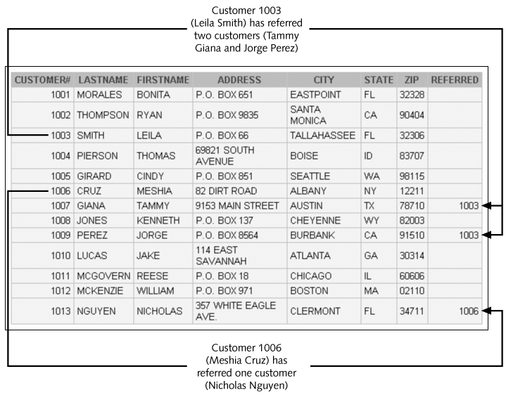
Customer Table Example
Oracle 11g: SQL

Slide 7
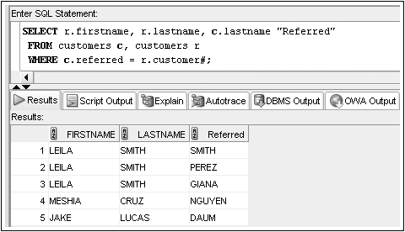
Self-Joins: WHERE Clause Example
Oracle 11g: SQL

Slide 8
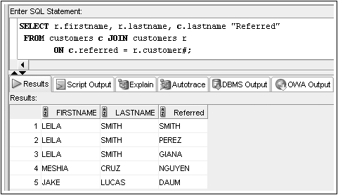
Self-Joins: JOIN…ON Example
Oracle 11g: SQL

Slide 9
Outer Joins
Use outer joins to include rows that do not have a match in the other table
In WHERE clause, include outer join operator (+) immediately after the column name of the table with missing rows to add NULL rows
In FROM clause, use FULL, LEFT, or RIGHT with OUTER JOIN keywords
Oracle 11g: SQL

Slide 10
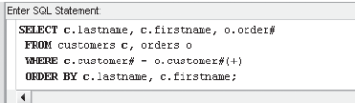
Outer Joins: WHERE Clause Example
Oracle 11g: SQL

Slide 11
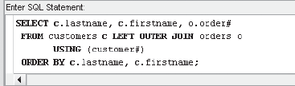
Outer Joins: OUTER JOIN Keyword Example
Oracle 11g: SQL

Slide 12

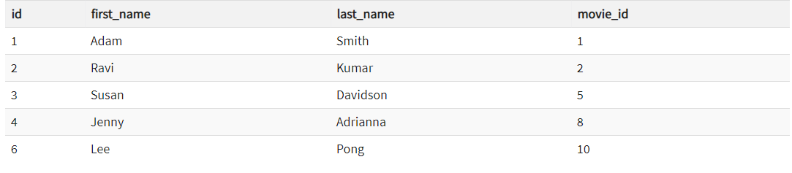
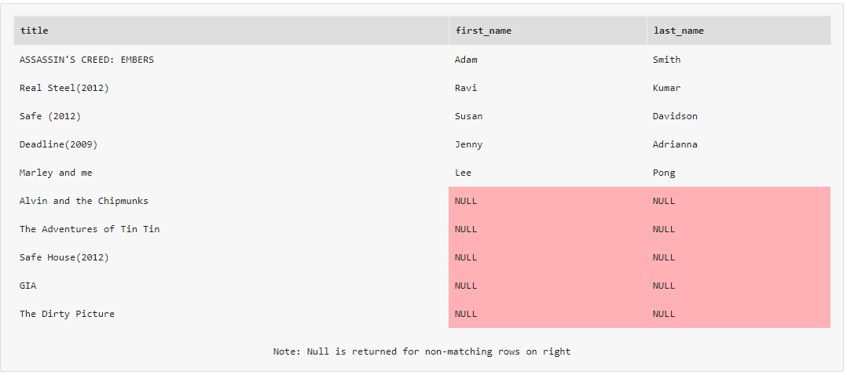
Left Outer joins explained
Oracle 11g

Slide 13
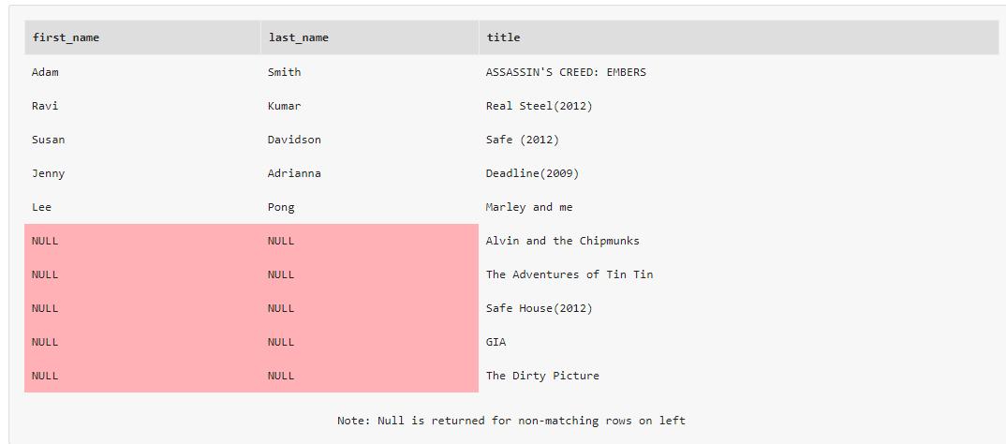
Right Outer Join
Oracle 11g

Slide 14
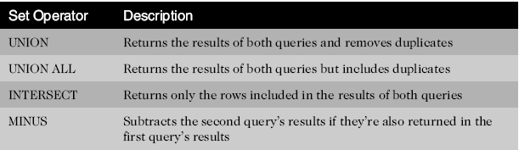
Set Operators
Used to combine the results of two or more SELECT statements
Oracle 11g: SQL

Slide 15
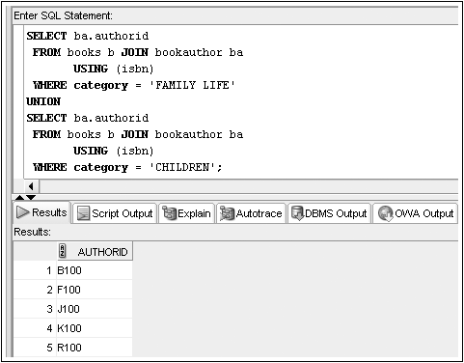
Set Operators: UNION Example
Oracle 11g: SQL

Slide 16
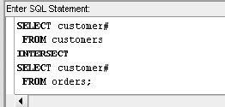
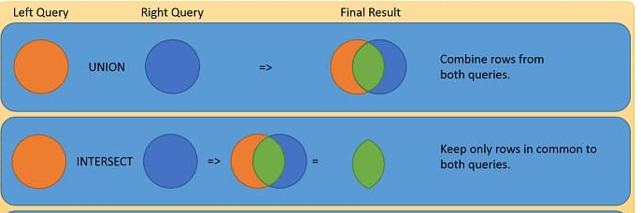
Set Operators: INTERSECT Example
Oracle 11g: SQL

Slide 17
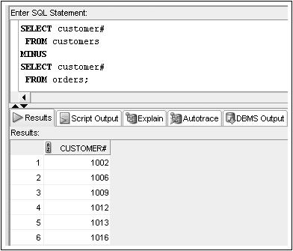
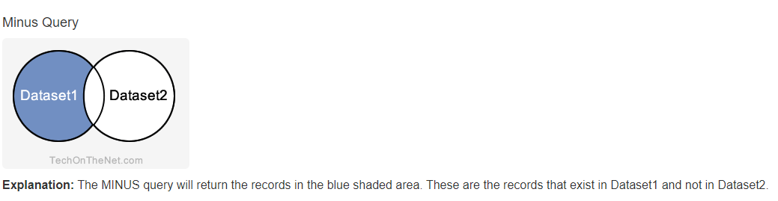
Set Operators: MINUS Example
Oracle 11g: SQL

Slide 18
Summary
Data stored in multiple tables regarding a single entity can be linked together through the use of joins
A Cartesian join between two tables returns every possible combination of rows from the tables; the resulting number of rows is always m * n
An equality join is created when the data joining the records from two different tables are an exact match
A non-equality join establishes a relationship based upon anything other than an equal condition
Self-joins are used when a table must be joined to itself to retrieve needed data
Oracle 11g: SQL

Slide 19
Summary (continued)
Inner joins are categorized as being equality, non-equality, or self-joins
An outer join is created when records need to be included in the results without having corresponding records in the join tables
  The record is matched with a NULL record so it will be included in the output
Set operators such as UNION, UNION ALL, INTERSECT, and MINUS can be used to combine the results of multiple queries
Oracle 11g: SQL

